Slide 1

Company for Electronic
Applications
www.seapraha.cz

Slide 2

Company SEA spol. s r.o. was founded in 1992.
We specialize on development, production and distribution of electronics.
The main focus is on GSM applications:
GSM modems, GSM routers a GSM communicators
for monitoring and remote control

Slide 3
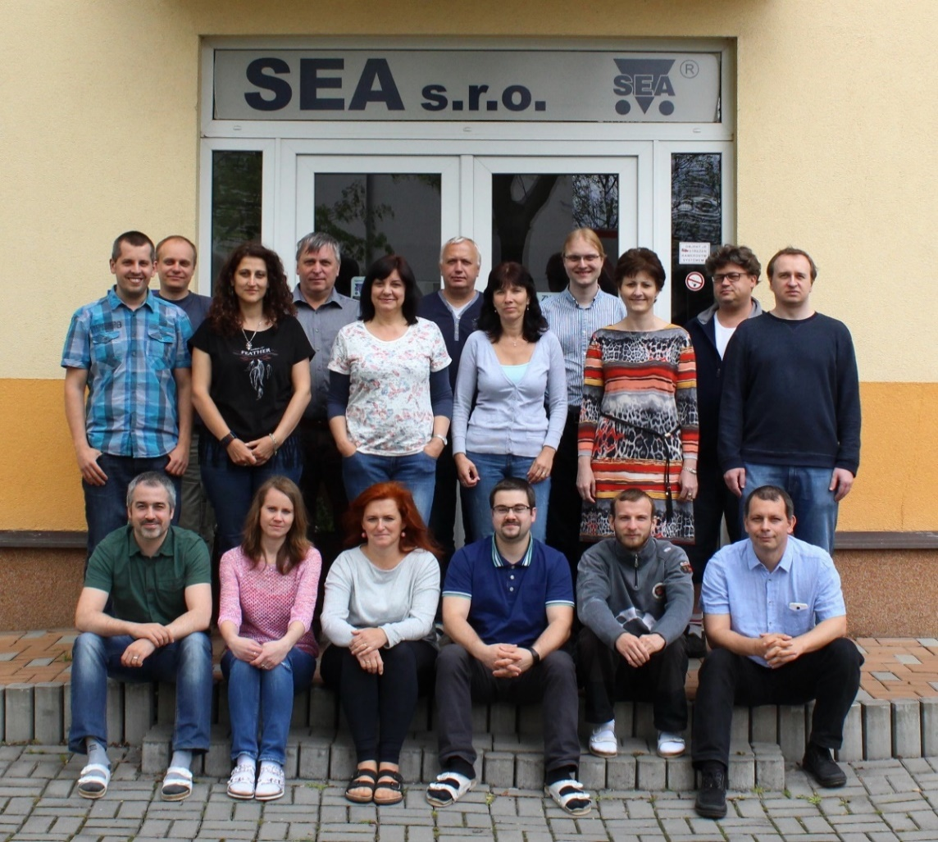
We are on the market more than 25 years
There is a team of specialists
with years of experience in the field
We have our own SW and HW
development
We provide all services and support
All productions take place
in the Czech Republic

Slide 4
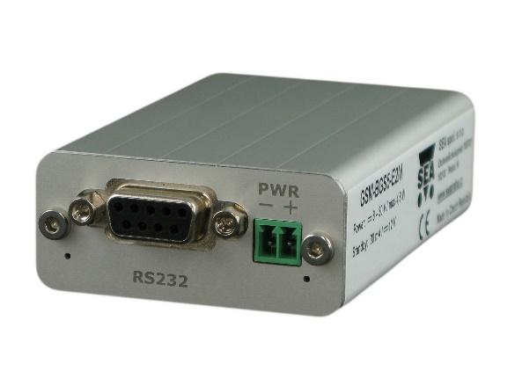
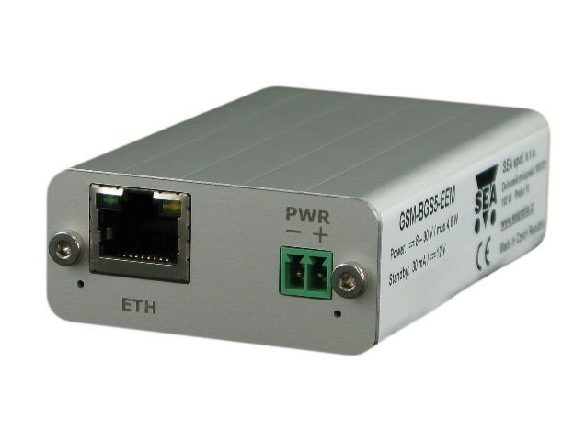
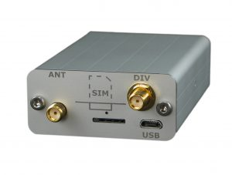
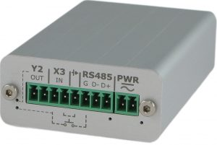
Our own GSM Products
GSM Modems
2G modem, ports RS232
and USB
2G modem, ports RS232
and Ethernet
2G modem, ports RS485
and USB
4G modem, ports RS232
and USB

Slide 5

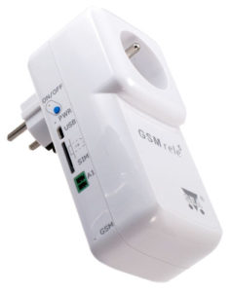
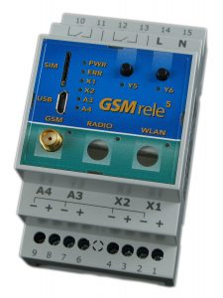
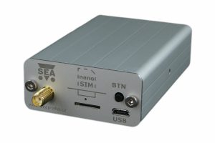
Our own GSM Products
GSM Communicators
GSM terminal
1x dig. input
1x dig. output
1x analog. input
GSM relay DIN
2x dig. input
2x dig. output
2x analog. input
GSM processor
7x dig. input
8x dig. output
2x analog. input
GSM relay socket
1x dig. input
1x dig. output 230V
1x analog. input

Slide 6
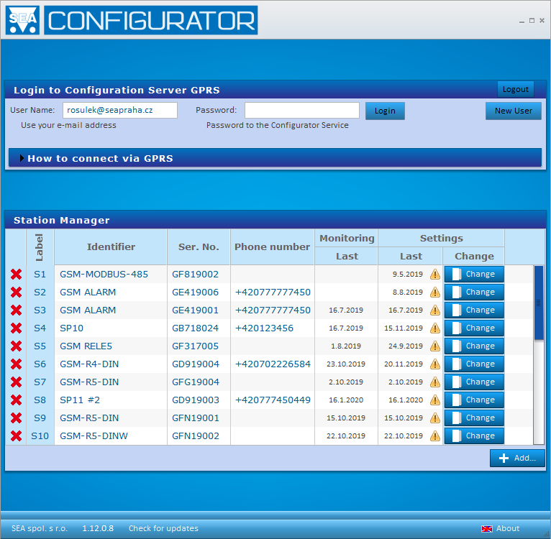
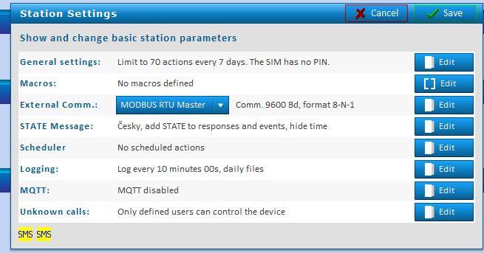
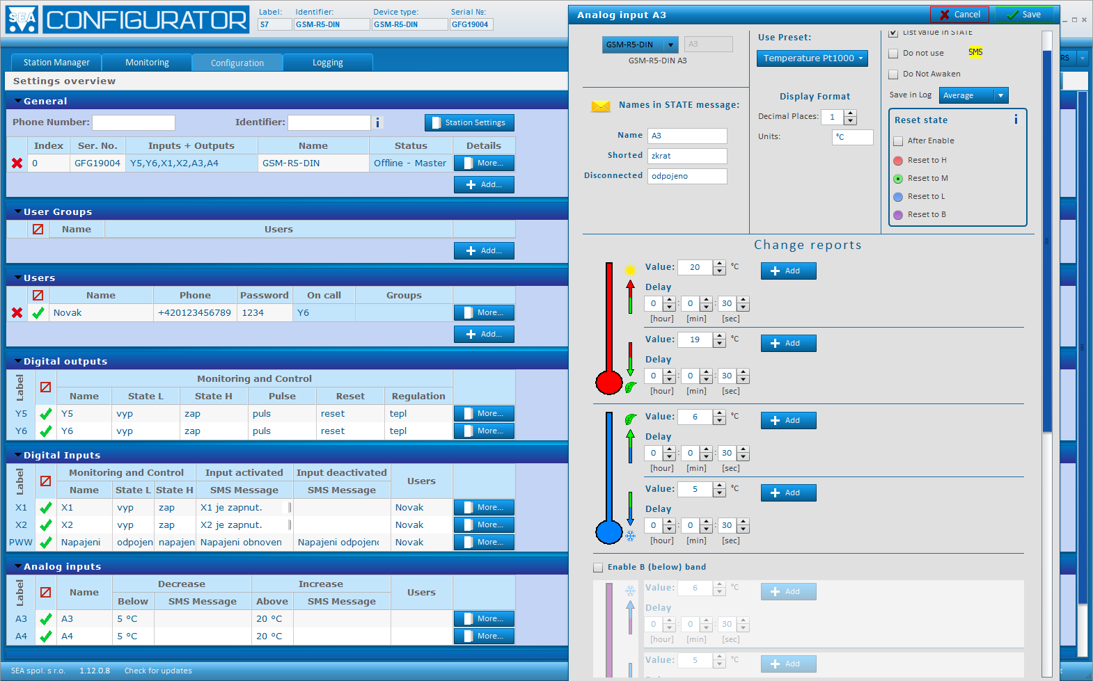
Our own GSM Products
SeaConfigurator – software for setup of GSM products

Slide 7
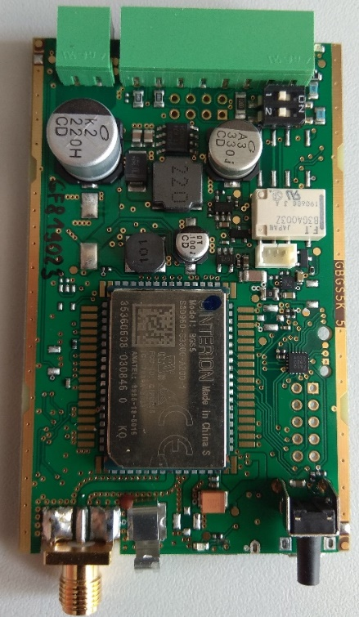
Electronics development
We specialize in development, manufacturing (EMS – Electronics Manufacturing Services) and assembling of electronics, especially in the field of GSM applications and customer electronics.
Our advantages
Individual approach to each project
Complete developement incl. mechanical work
HW and SW development
Production of prototypes
Own assembly line

Slide 8
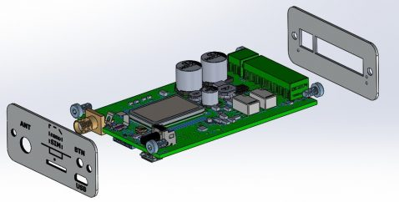
Electronics development
Development phases
Analysis for each development work
Mechanical construction
Circuit design
PCB design
Software – Firmware
Production of samples

Slide 9
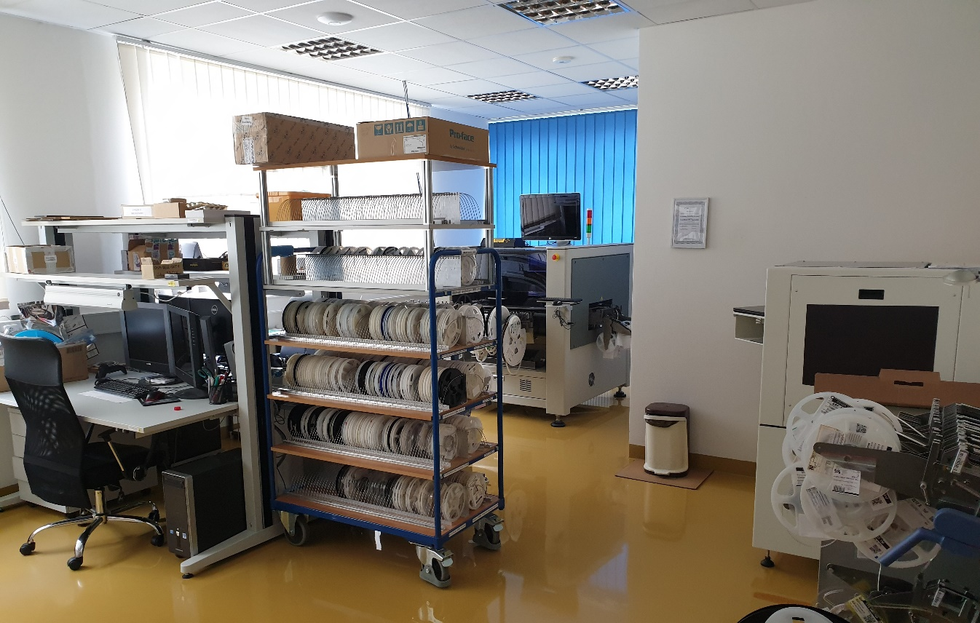
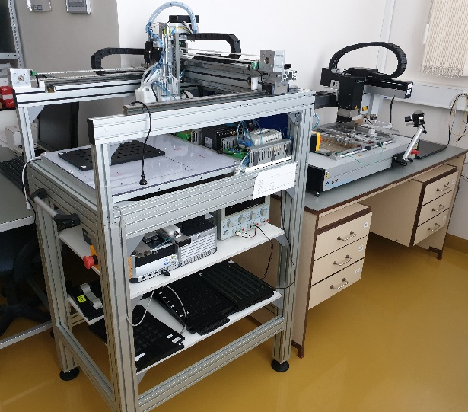
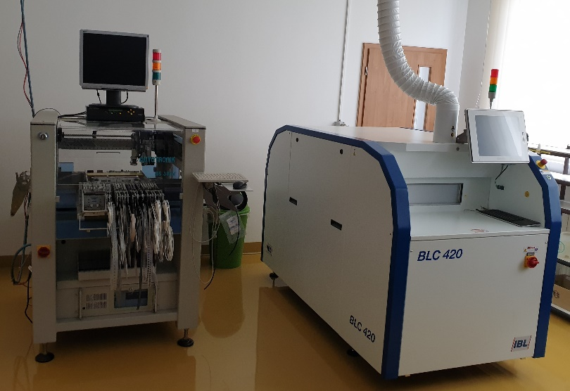
EMS – Electronics Manufacturing Services – serial and prototype production
Automatic Stencil Printer
camera system, adjustable separation distance and speed
PCB Assembly
3 assembly heads,
10 500 components/hour,
components min. size 01005
Vapour Phase Soldering
Inert atmosphere, high soldering quality
Automatic Optical Inspection
8 side camera, detection of quality soldering

Slide 10
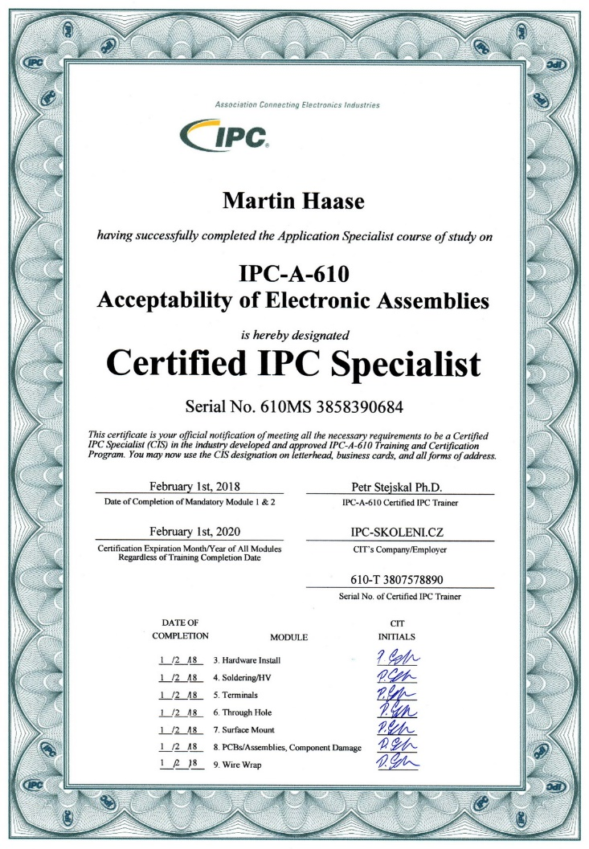
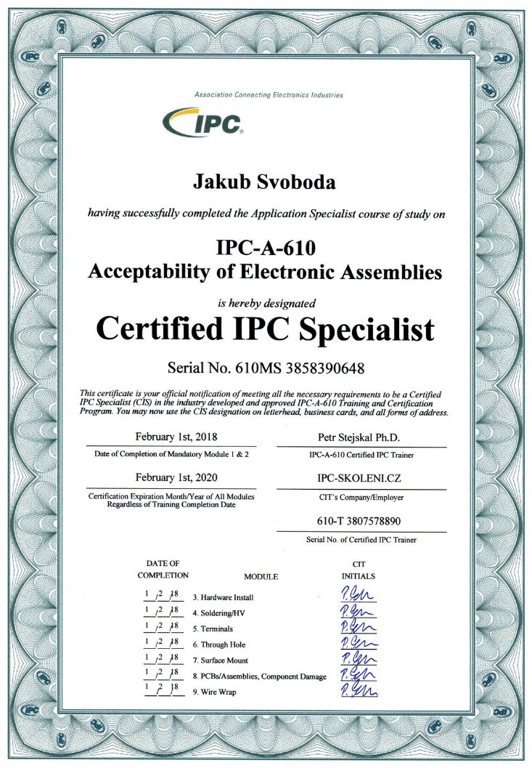
Certification

Slide 11





Main customers
Supply of GSM modems
Supply of GSM communicators
Exclusive supply of electronics
Development and supply of light tester
Electronics development
Development and supply of light tester

